Slide 1


Vivek Kumar
27/03/2023

Slide 2

Outline
Executive Summary
Introduction
Methodology
Results
Conclusion
Appendix

Slide 3
Executive Summary
Summary of methodologies
- Data Collection Through an API
- Data Collection with Web Scraping
- Data Wrangling
- Exploratory Data Analysis with SQL
- Exploratory Data Analysis with Data Visualization
- Analysis with Folium
- Machine Learning Approach
Summary of all results
- EDA Result
- Prediction Result

Slide 4
Introduction
Project background and context
Space X advertises Falcon 9 rocket launches on its website with a cost of 62 million dollars; other providers cost upward of 165 million dollars each, much of the savings is because Space X can reuse the first stage. Therefore, if we can determine if the first stage will land, we can determine the cost of a launch. This information can be used if an alternate company wants to bid against space X for a rocket launch. This goal of the project is to create a machine learning pipeline to predict if the first stage will land successfully.
Problems you want to find answers
I want to find all the of successful landing of Falcon9.
What approach should I try to based on answers, so that my company space Y’s rockets will land successfully.

Slide 5

Section 1

Slide 6
Methodology
Executive Summary
Data collection methodology:
The SpaceX Dataset was collected through hitting an API, and rest were scraped from Wikipedia.
Perform data wrangling
After collecting the data, we filtered the dataset having BoosterVersion with falcon9, and Applied Encoding.
Perform exploratory data analysis (EDA) using visualization and SQL
Perform interactive visual analytics using Folium and Plotly Dash
Perform predictive analysis using classification models
How to build, tune, evaluate classification models

Slide 7
Data Collection
Describe how data sets were collected.
The First Data was collected through an API and that HTML data then converted into json that contains link of API. Using that link data was fetched using loop and then converted into dataframe.
The Second Data was collected with web scarping from Wikipedia. The html was scraped from there and applied request function to read the html data. After, with the help of library ‘BeautifulSoup’ we scraped all the data that were said to scrape.
You need to present your data collection process use key phrases and flowcharts

Slide 8
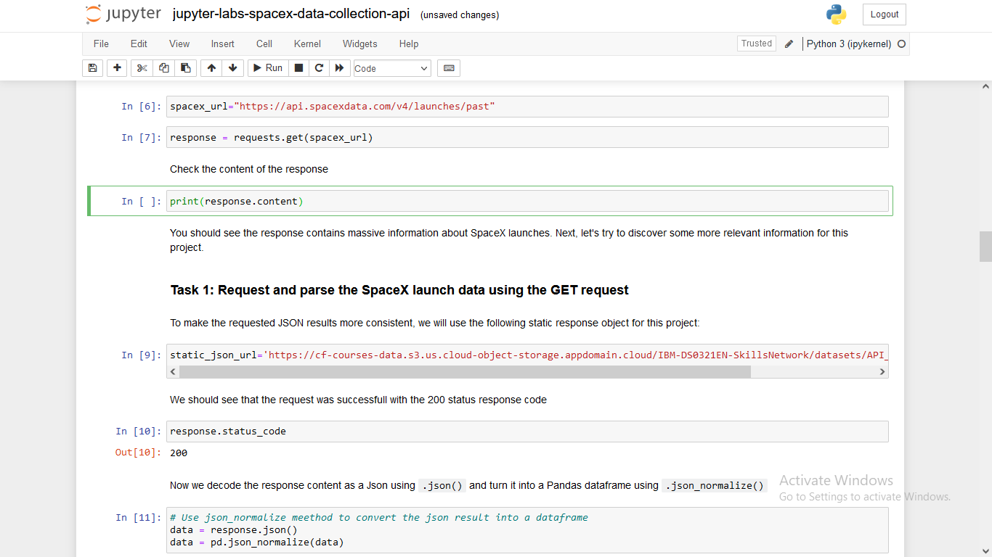
Data Collection – SpaceX API
Fetching Data with an API
GitHub URL of the completed SpaceX API calls notebook
https://github.com/vivekkumar011018/IBM-DataScience-Capstone-SpaceX/blob/main/jupyter-labs-spacex-data-collection-api.ipynb
Place your flowchart of SpaceX API calls here

Slide 9
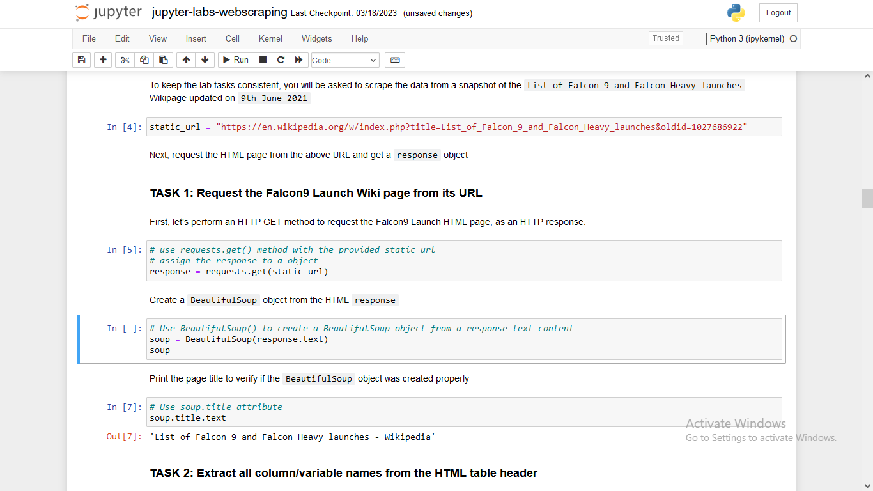
Data Collection - Scraping
The html was scraped from wikipedia and applied request function to read the html data. After, with the help of library ‘BeautifulSoup’ we scraped all the data that were said to scrape.
GitHub URL of the completed web scraping notebook,
https://github.com/vivekkumar011018/IBM-DataScience-Capstone-SpaceX/blob/main/jupyter-labs-webscraping.ipynb
Place your flowchart of web scraping here

Slide 10
Data Wrangling
Describe how data were processed
1. After getting the dataset, we calculated % of missing values in a dataset.
2. Calculated number of launches on each site, and number of occurrence of each orbit
3. calculated the number and occurrence of mission outcome per orbit type.
GitHub URL of your completed data wrangling related notebooks,
https://github.com/vivekkumar011018/IBM-DataScience-Capstone-SpaceX/blob/main/spacex-Data%20wrangling.ipynb

Slide 11
EDA with Data Visualization
Summarize what charts were plotted and why you used those charts
Scatterplot, Barchart, and Lineplot charts were plotted to observe the relationship between payload and launch site, visualize the relationship between success rate of each orbit type, and launch success yearly trend.
Add the GitHub URL of your completed EDA with data visualization notebook, as an external reference and peer-review purpose
https://github.com/vivekkumar011018/IBM-DataScience-Capstone-SpaceX/blob/main/jupyter-labs-eda-dataviz.ipynb

Slide 12
EDA with SQL
Using bullet point format, summarize the SQL queries you performed
We performed sql queries on spacex dataset, in jupyter notebook.
We displayed the unique launch sites in the space misiion
Displayed 5 records where sites begin with the string ‘CCA’
Displayed the average payload mass carried by booster version F9 1.1
GitHub URL of your completed EDA with SQL notebook
https://github.com/vivekkumar011018/IBM-DataScience-Capstone-SpaceX/blob/main/jupyter-labs-eda-sql-coursera.ipynb

Slide 13
Build an Interactive Map with Folium
Summarize what map objects such as markers, circles, lines, etc. you created and
We added to a folium map and applied marker on each launch sites.
Aplied Folium.circle to circle NASA Johnson Space Center on map.
Explain why you added those objects
Add the GitHub URL of your completed interactive map with Folium map,
https://github.com/vivekkumar011018/IBM-DataScience-Capstone-SpaceX/blob/main/lab_jupyter_launch_site_location%20(Folium).ipynb

Slide 14
Build a Dashboard with Plotly Dash
We built an interactive dashboard with Plotly dash
We plotted pie charts showing the total launches by a certain sites
We plotted scatter graph showing the relationship with Outcome and Payload Mass (Kg) for the different booster version.

Slide 15
Predictive Analysis (Classification)
In a given dataset, we performed standardscaler to scale the data, then applied train test split.
Now I applied multiple classification algorithms using gridsearchcv to get the best parameter, and found the decision tree was the best performing model.
After applying the model and parameter, we user accuracy_score, confusion_mtrix to check which model is best.
https://github.com/vivekkumar011018/IBM-DataScience-Capstone-SpaceX/blob/main/SpaceX_Machine%20Learning%20Prediction_Part_5.ipynb

Slide 16
Results
Exploratory data analysis results
Interactive analytics demo in screenshots
Predictive analysis results

Slide 17

Section 2

Slide 18
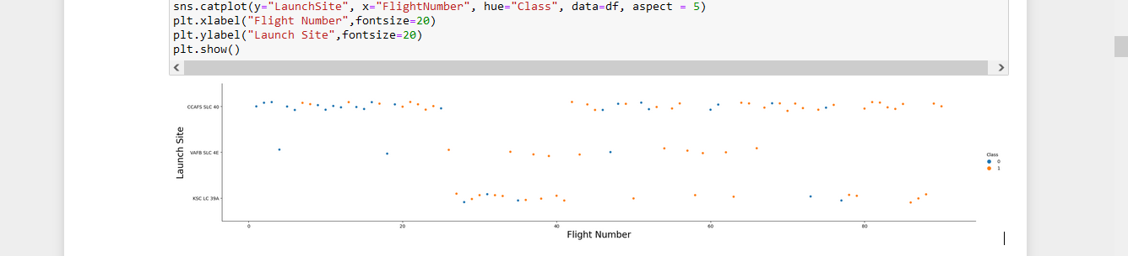
Flight Number vs. Launch Site
According to graph, as the flight number increases, success rate at each launch site increases.

Slide 19
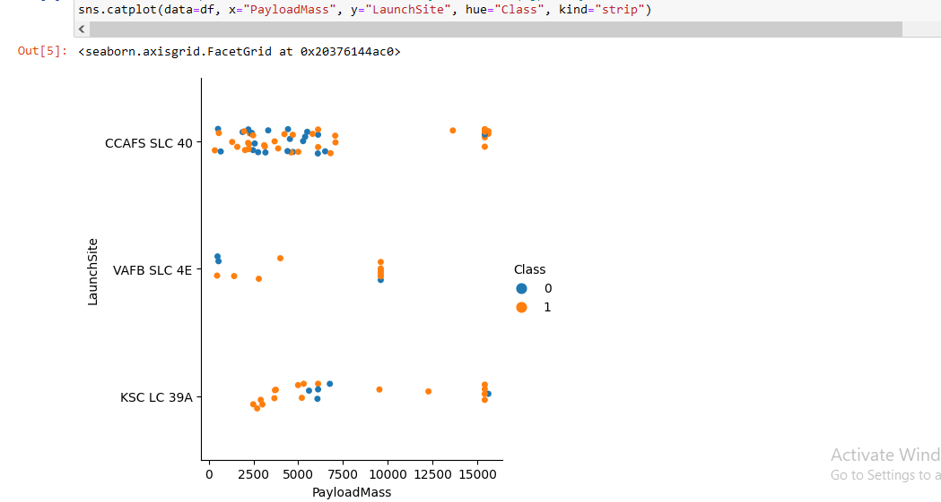
Payload vs. Launch Site
According to graph, rockets with high payload mass, is never launched from VAFB SLC SE, launch site.

Slide 20
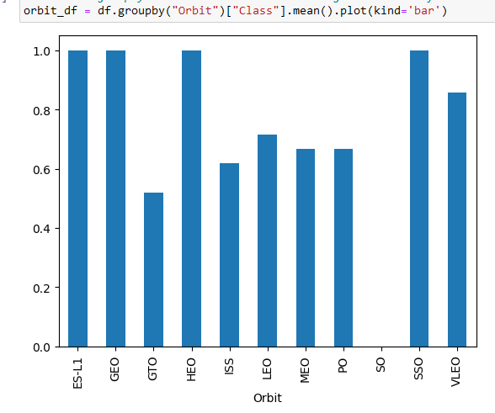
Success Rate vs. Orbit Type
From Graph, ES-L1, GEO, HEO, SSO, VLEO have highest success rate.

Slide 21
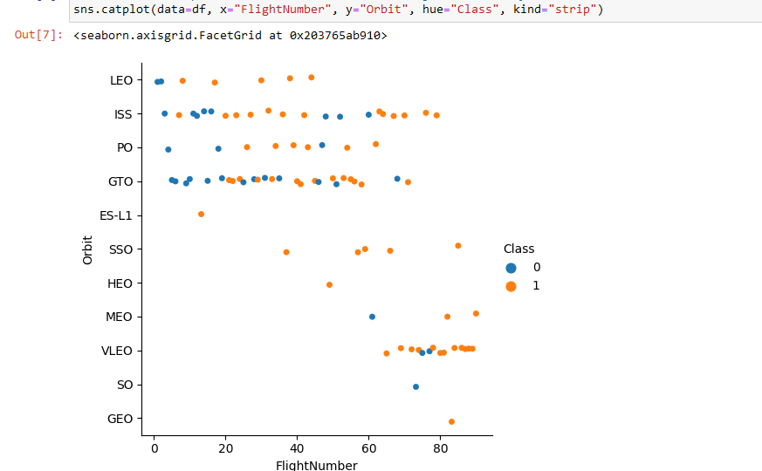
Flight Number vs. Orbit Type
We can see, LEO orbit type has success as flight number increases.

Slide 22
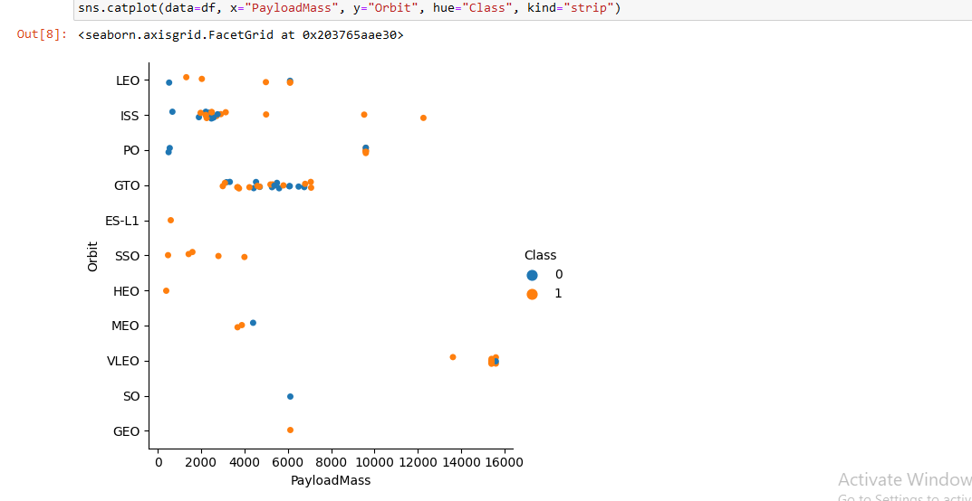
Payload vs. Orbit Type
As the payloadmass increases, we can observe that LEO, ISS, SSO has a positive success rate.

Slide 23
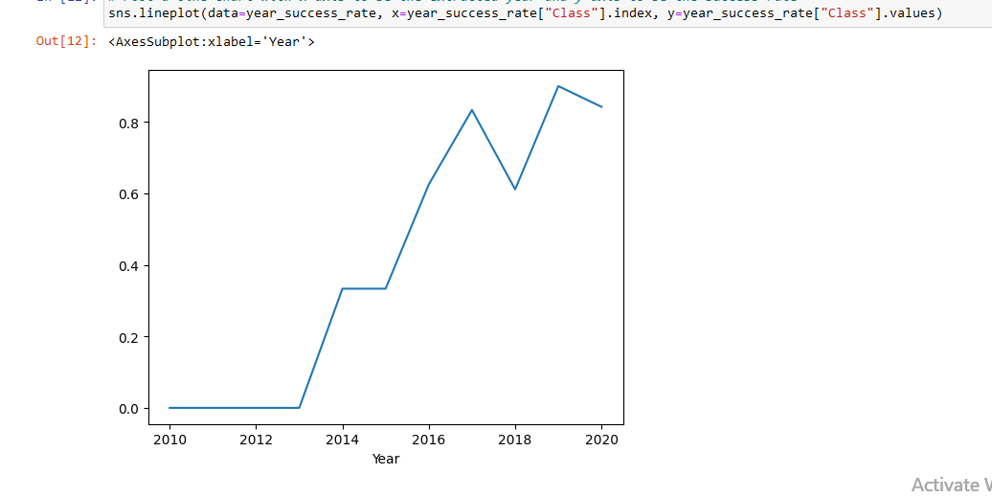
Launch Success Yearly Trend
From year 2013, success rate kept increasing.

Slide 24
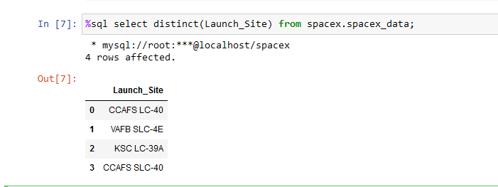
All Launch Site Names
Applied distinct function to get all the unique launch sites from spacex dataset.

Slide 25
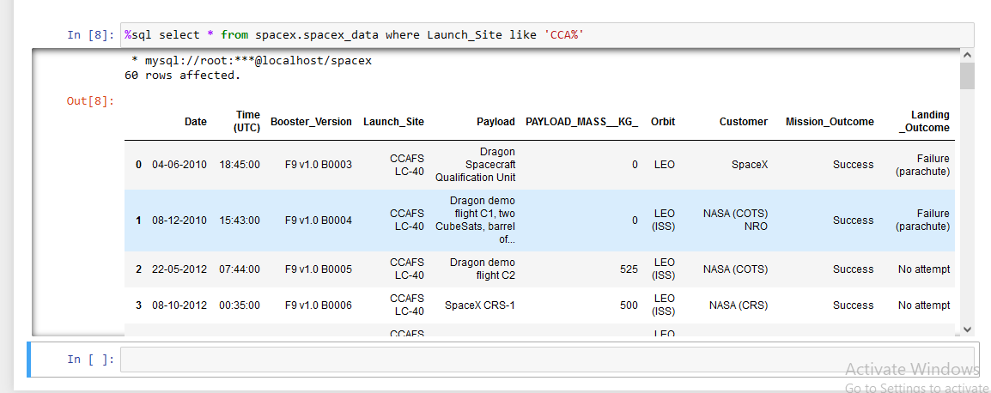
Launch Site Names Begin with 'CCA'
So, there we 60 records in spacex dataset, where name of launch sites begin with ‘CCA’

Slide 26
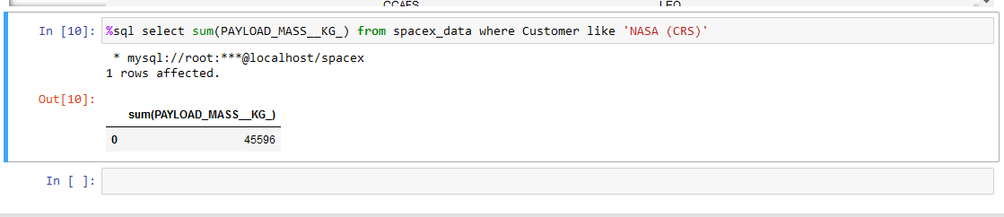
Total Payload Mass
Total payload mass launched by NASA(CRS) is 45596

Slide 27
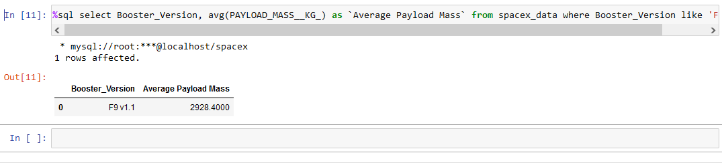
Average Payload Mass by F9 v1.1
Got the average payload mass as 2928.4 by F9 v1.1

Slide 28
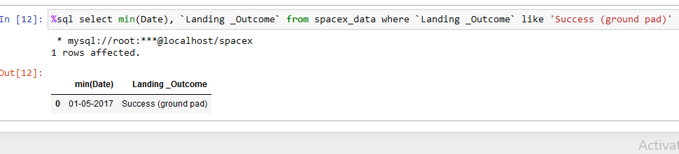
First Successful Ground Landing Date

Slide 29
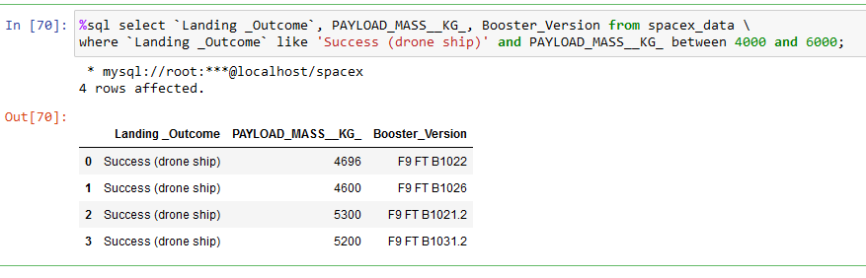
Successful Drone Ship Landing with Payload between 4000 and 6000
In this query, we used where clause to filter the dataset with landing outcome (Success (drone ship)) and between clause.

Slide 30
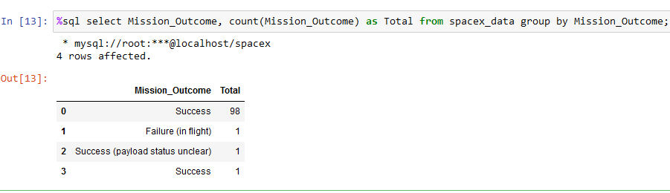
Total Number of Successful and Failure Mission Outcomes
As you can see, total success is 100 and 1 failure.

Slide 31
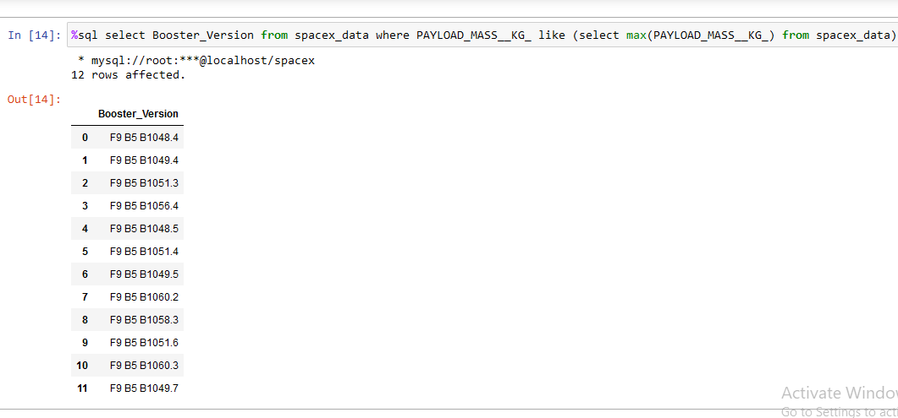
Boosters Carried Maximum Payload
So, found that there are total 11 booster_version with maximum payload mass.

Slide 32
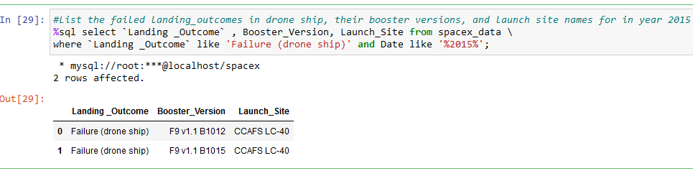
2015 Launch Records
To fetch this data, we used where clause with like operator.

Slide 33
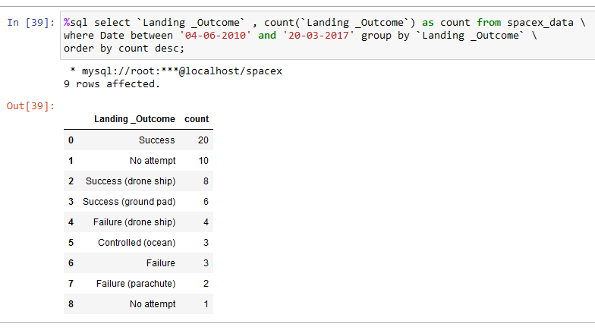
Rank Landing Outcomes Between 2010-06-04 and 2017-03-20
Used groupby on landing outcome and applied order by in descending order.

Slide 34

Section 3

Slide 35
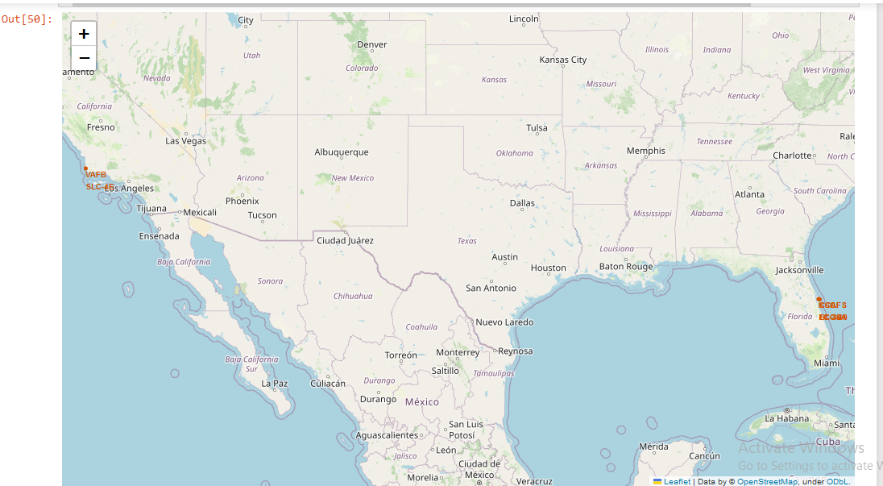
<Folium Map Screenshot 1>
We can see that 1 launch site is near los angles, and rest other as at cape carnival space force station.

Slide 36

<Folium Map Screenshot 2>
Here green marker is successful and red marker is failure launches.

Slide 37

<Folium Map Screenshot 3>

Slide 38

Section 4

Slide 39

<Dashboard Screenshot 1>
Replace <Dashboard screenshot 1> title with an appropriate title
Show the screenshot of launch success count for all sites, in a piechart
Explain the important elements and findings on the screenshot

Slide 40

<Dashboard Screenshot 2>

Slide 41

<Dashboard Screenshot 3>

Slide 42

Section 5

Slide 43
Classification Accuracy
Visualize the built model accuracy for all built classification models, in a bar chart
Find which model has the highest classification accuracy

Slide 44
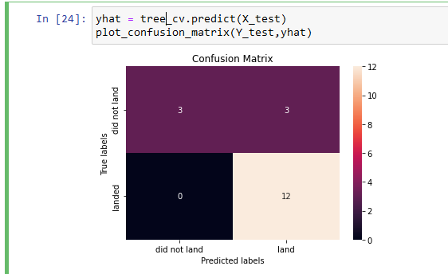
Confusion Matrix
Show the confusion matrix of the best performing model with an explanation

Slide 45
Conclusions
We can conclude that:
The larger the flight amount at a launch site, the greater the success rate at a launch site.
Launch success rate started to increase in 2013 till 2020.
Orbits ES-L1, GEO, HEO, SSO, VLEO had the most success rate.
KSC LC-39A had the most successful launches of any sites.
The Decision tree classifier is the best machine learning algorithm for this task.

Slide 46


